Slide 1
Wine In The Bible
Notes:
With just a quick look through the Bible, it is easy to see that God has lots to say about alcohol and wine.
We have passages like Proverbs 23:29-35
Then, We have passages like John 2…where Jesus turns water into wine. And we can’t help but ask? What is this passage showing us and teaching us about this topic.
So today we are going to begin dealing with some of these issues. I want us to begin by recognizing TWO really Big FACTORS…
An important and challenging study…

Slide 2
Studying Wine In The Bible
There Is An Academic Examination.
Many Hebrew & Greek Terms
Many Historical Practices & Insights (Matt 9:17)
Interconnected Commands (Romans 14:21, 1 Peter 4:2-7)
Helpful Contextual Details (John 2:6)
There Are Also Life & Death Consequences In Our Applications.
Hebrews 5:14
Notes:
Academic.
Matt 9:17 – people overlook sometimes that Jesus is talking about the process of PRESERVATION. The Jews knew not only how to make fresh wine, but also how they could best preserve it for use long after the grape harvest was over.
Rom 14:21 – This is a topic where we don’t just think about how our decisions effect us, but how our decisions effect others.
Application… Steve Klein’s Phone call…
GIVEN THESE TWO FACTORS: This Calls For Both Teachers & Students To Give Their Best.
As I’m teaching, I need to give you God’s word with great care. In matters of doctrine I need to be uncompromising, and in matters of judgment I need to give the best guidance possible.
As students, you need to avoid over-simplifying the issue, and you need to avoid picking and choosing verses to rationalize destructive behavior.
***My Point is: This is not a topic to take lightly. There are very legitimate questions that need to be asked…There must also be wisdom to avoid any practice that could ruin people’s lives and even cost them their souls.

Slide 3
Foundations: The Bible Words For Wine
Key Hebrew Terms
Yayin, H3196: Genesis 9:21 “wine”
Shakar, H7937: Genesis 9:21 “drunken”
Shekar, H7941: Leviticus 10:9 “strong drink”
Tiyrosh, H8492: Genesis 27:28 “wine”
Fresh grape juice, rarely fermented
Judges 9:13, Isaiah 65:8, Proverbs 3:10
Notes:
10 Hebrew Terms To Refer to Wine and Drunk
7937 pronounced Shak-Hair
7941 pronounced Shey - Har

Slide 4
Foundations: The Bible Words For Wine
Key Greek Terms
Oinos, G3631: John 2:9-10, Mt 9:17 “wine”
Gleukos, G1098: Acts 2:13 “new wine”
Septuagint For Job 32:19 (Hebrew Yayin)
Oxos, G3690: Matthew 27:48 “vinegar”
Sikera, G4608: Luke 1:15 “strong drink”
THE POINT: These words have such broad usages, the context is vital.
Notes:
Oin-us
MATTHEW 27:
Vs. 34 – Oinos, he would not drink.
Vs. 48 – Oxos, he would drink. Vinegar
Luke 1:15 - See-care-ah
THE POINT: Don’t assume that anytime you see the word “wine” it is alcoholic. Oinos or “wine” can be used for everything from fresh grape juice to fermented wine.

Slide 5
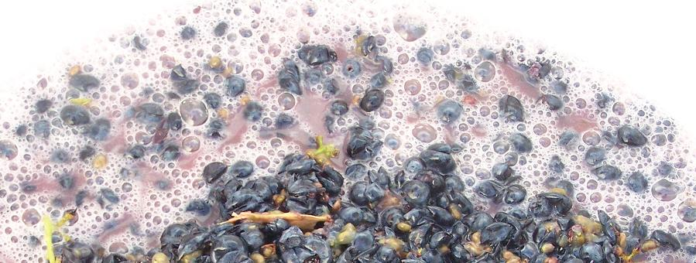
Foundations: Fermentation In The First Century
Yeast Reacts With The Sugar, Converting The Sugar Into Alcohol & Producing Carbon Dioxide As A By-Product. Can Rise To 12%.
Notes:
Most of the YEAST is killed once the alcohol level reaches 12%. So the natural chain reaction stops at about 12% alcohol content.

Slide 6
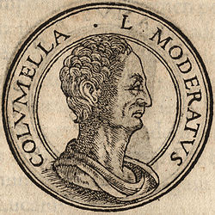
Foundations: Fermentation In The First Century
1st Century People WERE ABLE TO Preserve Grape Juice Over A Long Time.
Lucius Junius Moderatus Columella (4 to 70 AD)
Pliny the Elder: wine “with strength reduced by filter” has its “strike and madness taken away” leaving one in a “mild and healthy state of mind.”
Cato the Elder (234 – 149 BC) wine stored in a jar coated with pitch and submerged for 30 days could be kept as “must” for 1 year.
Notes:
“Must” could be boiled down to a thick syrup and/or filtered.
Containers could be filled to capacity to remove oxygen, and then stored in cool temperatures in the ground.

Slide 7
Foundations: Comparing Apples To Oranges
1st Century Wine Had LOWER Alcohol Content Than Today’s Wines.
1st Century “Wine” ~ 0% or ~ 4 to 6% Alcohol
1st Century Strong Drink ~ 7% to 10%, Max of 14%
Modern Wine ~ 8% to 15% and some 22%
Modern Liquors ~ 40% to 50% up to nearly 80%
In Addition To Lower Alcohol Content, 1st Century Wine Was Also Regularly Mixed With Water.
20 to 1 (Homer, Odyssey)
8 to 1 (Pliny, Natural History)
Among The Jews: 2 to 1, or 3 to 1 (Shabbat, Pesachim)
Notes:
They could preserve it. And when they didn’t it was still not the same as modern wine.
CUTTING WITH WATER: So that first Century Wine is going to suddenly go from about 4% to about 2% even less!
Modern Wine Makers – add sugars to increase the fermentation, and even “fortify” which just means add – extra alcohol once the fermentation is complete. Today’s wine is NOT the same as the wine of the 1st Century. It is 2, 3, or 4 times more alcoholic!
THE POINT: If you want to avoid the “strong drink” of the Bible – Not only do you have to avoid all modern Liquors, but you also have to avoid all modern wines.
Please don’t assume “wine” is just “wine”

Slide 8
Studying Wine In The Bible
We Must Study With Great Care & Wisdom!
Wine is a mocker, strong drink a brawler, And whoever is intoxicated by it is not wise. (Proverbs 20:1)
We Cannot Oversimplify The Word Usage.
We Cannot Assume It Was All Fermented.
We Cannot Treat Today’s Alcoholic Beverages As If They Are The Same.
“Since We Are Of The Day, Let Us Be Sober…”
1 Thessalonians 5:8

Slide 9
Wine In The Bible
Notes:
Rather than living like the rest of the world
– our goal is to live like Jesus.
Rather than turn to a drink to feel better or deal with problems – we turn to GOD.

